Slide 1

Dr. Ammar Haider
Assistant Professor
School of Computing
CS3002 Information Security
Database Security

Slide 2
Database Systems
Collection of data stored for use by one or more applications
Contains the relationships between data items and groups of data items
Mostly contain sensitive data that needs to be secured
Query language: Provides a uniform interface to the database

Slide 3
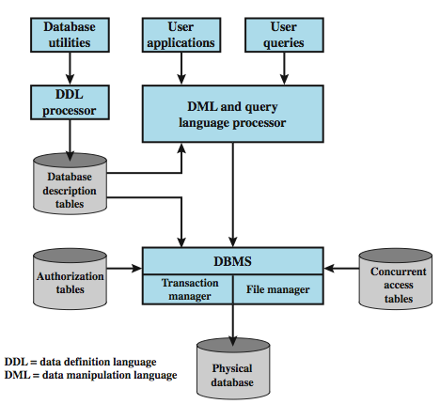
Database Architecture

Slide 4
Relational Databases
Table of data consisting of rows and columns
Each column holds a particular type of data
Each row contains a specific value for each column
Ideally has one column where all values are unique, forming an identifier/key for that row
Enables the creation of multiple tables linked together by a unique identifier that is present in all tables
Use a relational query language to access the database
Allows the user to request data that fit a given set of criteria

Slide 5
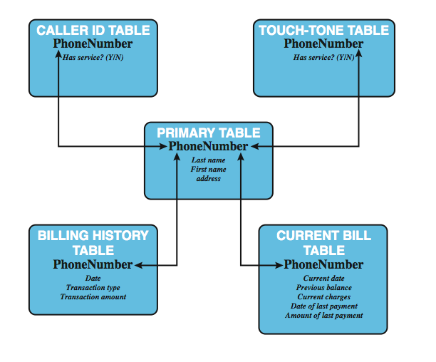
Relational Database Example

Slide 6
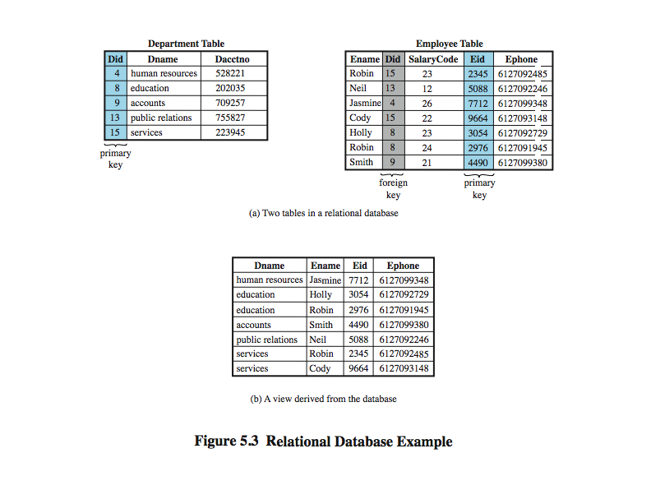
Relational Database Elements
Two tables in a db
A view derived from two tables

Slide 7
Structured Query Language
SQL: originally developed by IBM in the mid-1970s
standardized language to define, manipulate, and query data in a relational database
several similar versions of ANSI/ISO standard

Slide 8
SQL Examples
CREATE TABLE department (
Did INTEGER PRIMARY KEY, Dname CHAR (30), Dacctno CHAR (6) )
CREATE TABLE employee ( Ename CHAR (30), Did INTEGER, SalaryCode INTEGER, Eid INTEGER PRIMARY KEY, Ephone CHAR (10), FOREIGN KEY (Did) REFERENCES department (Did) )
CREATE VIEW newtable (Dname, Ename, Eid, Ephone) AS SELECT D.Dname E.Ename, E.Eid, E.Ephone FROM Department D JOIN Employee E ON E.Did = D.Did

Slide 9
SQL Injection Attacks

Slide 10
SQL Injection Attacks (SQLi)
One of the most prevalent and dangerous network-based security threats
Attacker sends malicious requests — containing SQL commands — to web (or application) server, which forward the commands to the database server
SQL injection can be exploited to:
Steal data in bulk
Modify or delete data
Execute arbitrary operating system commands
Launch denial-of-service (DoS) attacks

Slide 11
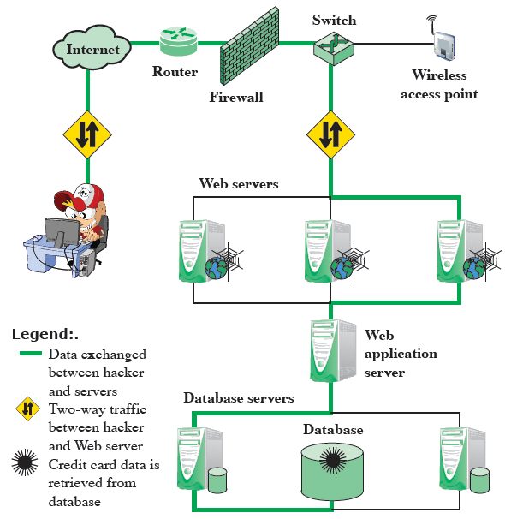
A typical injection attack

Slide 12
SQLi sequence of events
Hacker finds a vulnerability in a custom Web application and injects a SQL command to a database by sending the command to the Web server. The command is injected into traffic that will be accepted by the firewall.
The Web server receives the malicious code and sends it to the Web application server.
The Web application server receives the malicious code from the Web server and sends it to the database server.
The database server executes the malicious code on the database. The database returns data from (e.g.) credit cards table.
The Web application server dynamically generates a page with data including credit card details from the database.
The Web server sends the credit card details to the hacker

Slide 13
Injection Technique
The SQLi attack typically works by prematurely terminating a text string and appending a new command.
Injected string is terminated with SQL comment mark (--)
SELECT fname, lname, phone
FROM student
WHERE fname = 'user_input';
What if user types the following input?
John'; DROP TABLE course; --

Slide 14
Example SQL injection
Server-side C# code to get data from a web form
var ShipCity = Request.form("ShipCity"); var sql = "SELECT * FROM Orders WHERE ShipCity = '" + ShipCity + "';";
If user enters Redmond in the form, query becomes
SELECT * FROM Orders WHERE ShipCity = 'Redmond';
Suppose, however, the user enters the following in the form: Redmond'; DROP table Orders; --
This results in the following SQL query: SELECT * FROM Orders WHERE ShipCity = 'Redmond'; DROP table Orders; --';
Request.form() returns the data submitted by user in HTTP POST request body.

Slide 15
In-band attacks
In-band: same channel used for injecting SQL code and retrieving results. Such attacks can include one or more of the following elements:
Tautology: This form of attack injects code in one or more conditional statements so that they always evaluate to true
End-of-line comment: After injecting code into a particular field, legitimate code that follows are nullified through usage of end of line comments
Piggybacked queries: The attacker adds additional queries beyond the intended query, piggy-backing the attack on top of a legitimate request

Slide 16
Tautology Example
Server side PHP script
$query= "SELECT info FROM user WHERE name = '`$_GET["name"]`' AND pwd = '`$_GET["pwd"]`'";
Attacker submits following for the name field:
' OR 1=1 --
Query becomes
SELECT info FROM users
WHERE name = '' OR 1=1 -- AND pwd = ''
$_GET provides the data submitted by user in HTTP GET request URL (aka query string).

Slide 17
Using UNIONs
With the help of UNION operator, an attacker can retrieve data from other tables.
For example, if an application executes the following query (where shirts value is coming from client side)
SELECT name, description
FROM products
WHERE category = 'shirts';
An attacker can submit the input:
shirts' UNION SELECT username, password FROM users; --
which will make the server return all usernames and passwords along with the names and descriptions of products.

Slide 18
Inferential Attack (gathering info)
There is no actual transfer of data, but the attacker is able to reconstruct the information by sending particular requests and observing the resulting behavior of the website/database server
a) illegal/logically incorrect queries
lets an attacker gather important information about the type and structure of the backend database of a Web application
Considered as a preliminary step for further attacks.
The vulnerability leveraged by this attack is that the default error page returned by application servers is often overly descriptive.

Slide 19
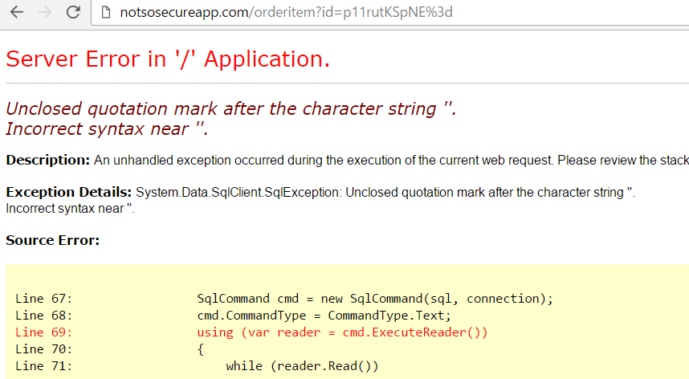
Inferential Attack (gathering info)
Example illegal query (missing whitespaces)
SELECT*FROM table_nameWHERE id=@id"
Possible web response, which reveals the server side script
https://notsosecure.com/anatomy-hack-sqli-crypto

Slide 20
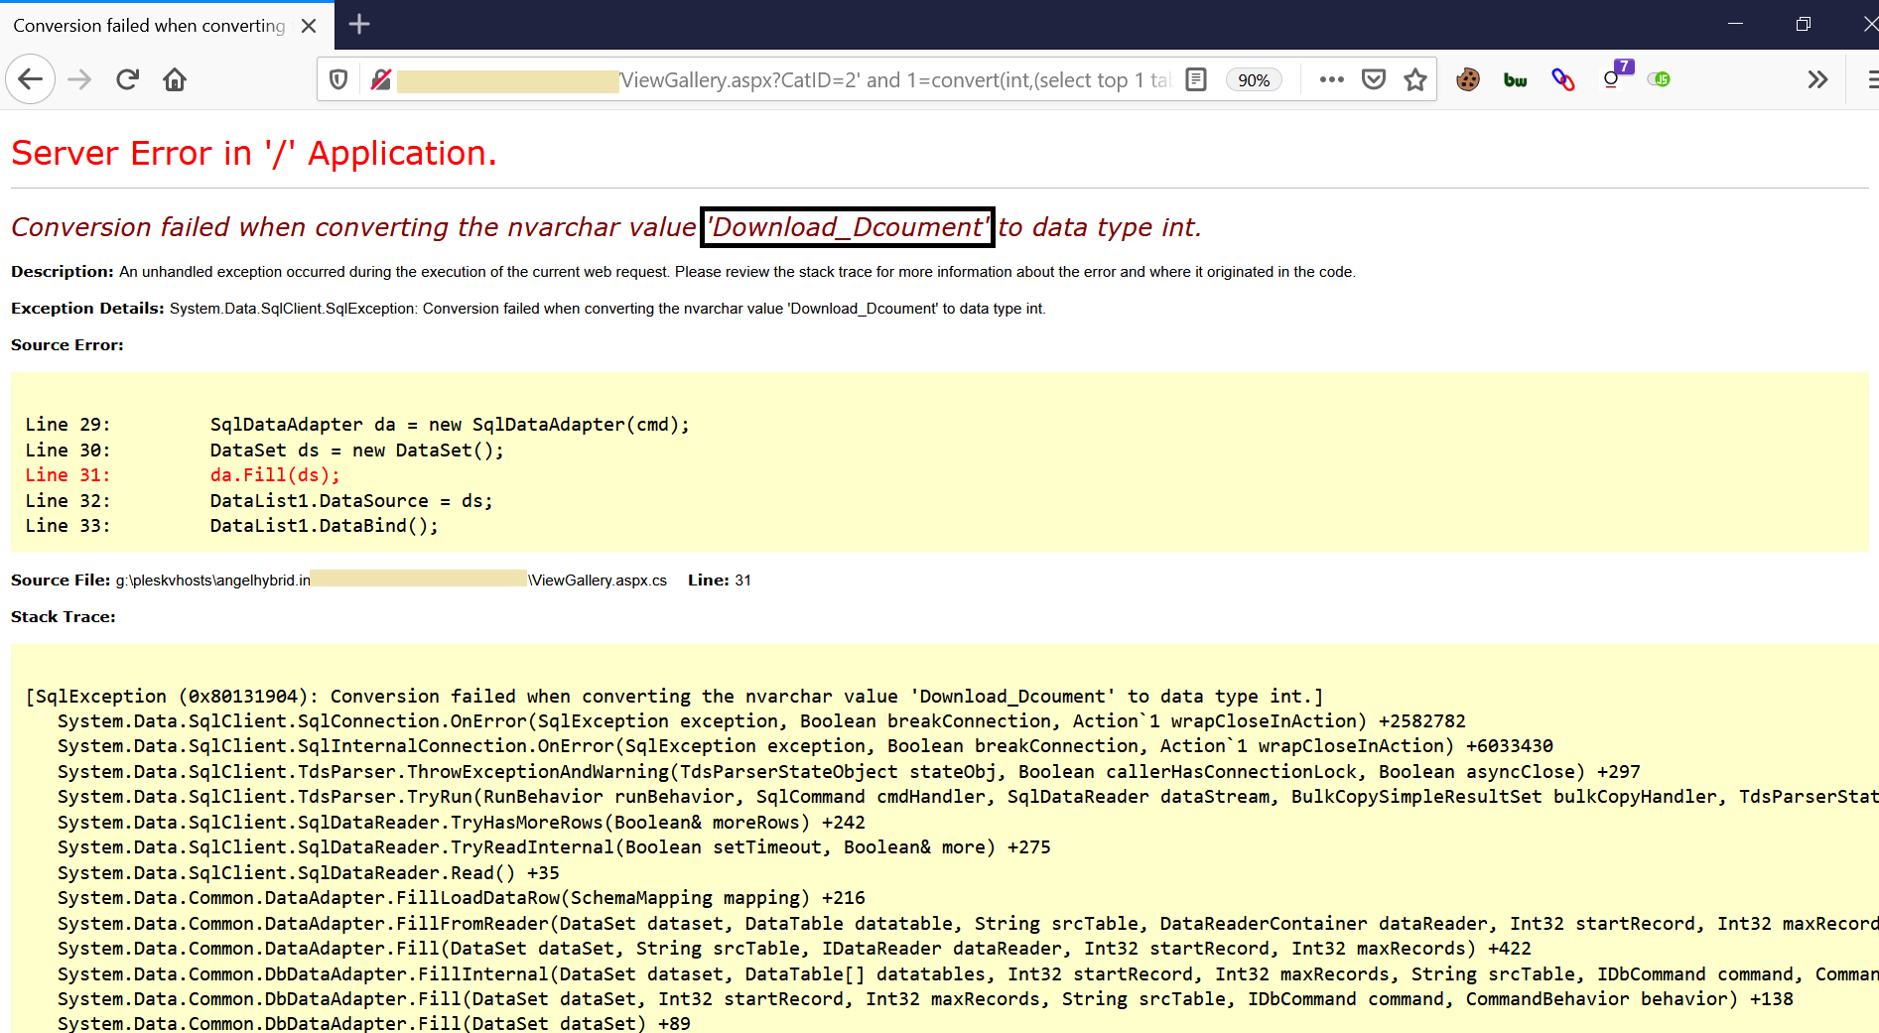
Inferential Attack (gathering info)
In other cases, database table and/or column names might be revealed.
https://infosecwriteups.com/exploiting-error-based-sql-injections-bypassing-restrictions-ed099623cd94

Slide 21
Inferential Attack (gathering info)
b) Blind SQL injection
Most systems have sufficient security in place to not display any erroneous information back to the attacker.
They could display a generic “404 Not Found” or “500 Internal Server Error” error page without revealing the exact database error message.
Blind injection is used in such cases. It allows attackers to infer the data present in a database system.
For example, the attacker asks the server true/false questions to observe the functionality in each case.

Slide 22
Inferential Attack (gathering info)
Blind SQL injection Example
Suppose the URL http://newspaper.com/items.php?id=2 sends the following query to the database:
SELECT title, descr, body FROM items WHERE ID = 2
The attacker may then try to inject a query that returns ‘false’:
http://newspaper.com/items.php?id=2 and 1=2
Now the SQL query should looks like this:
SELECT title, descr, body FROM items WHERE ID = 2 and 1=2
If the web application is vulnerable to SQLi, then it probably will not return anything (because WHERE clause is false). To make sure, the attacker will inject a query that will return ‘true’:
http://newspaper.com/items.php?id=2 and 1=1
If the content of this page is different from the previous one, then the attacker is able to verify that injection is working.
https://owasp.org/www-community/attacks/Blind_SQL_Injection

Slide 23
Denial-of-Service using SQLi
Attackers can also inject queries that cause DBMS to perform long useless calculations, draining all CPU resources. e.g.
Note: ENCODE(ptext, p) encrypts ptext with password p. DECODE performs decryption.
Imagine running above query on a database containing thousands of post entries.
SELECT DECODE(
ENCODE(
CONVERT(COMPRESS(post) USING latin1),
CONCAT(post, post, post, post)
),
SHA1(CONCAT(post, post, post, post))
) AS column1
FROM table_1;
https://www.securityidiots.com/Web-Pentest/SQL-Injection/ddos-website-with-sqli-siddos.html

Slide 24
SQLi attempts – Real example
Lee Penkman created a form on his website. It was hidden, so actual users could not see it, only bots (scanning for vulnerabilities) could see and submit it.
Here are some of the things submitted:
1 UNION ALL SELECT NULL#
-1 OR 2+456-456-1=0+0+0+1
wrBEIRqX'||DBMS_PIPE.RECEIVE_MESSAGE(CHR(98)||CHR(98)||CHR(98),15)||'
1;WAITFOR DELAY '0:0:5'—
(SELECT (CASE WHEN (2646=4989) THEN 2646 ELSE 2646*(SELECT 2646 FROM INFORMATION_SCHEMA.CHARACTER_SETS) END))
https://github.com/lee101/hidden-form-on-the-internet

Slide 25
SQLi countermeasures
(1) Using prepared statements (parameterized queries)
All database engines support this feature, to distinguish between SQL code and data.
Usage steps:
write the full SQL query, inserting placeholders (typically ‘?’) for the parameter values. We may call it a parametrized statement.
call prepare function of database engine. It will parse the statement into a query.
finally, bind the parameters to query. This way, bound values will always be interpreted as data, even if they contain any malicious sql.

Slide 26
SQLi countermeasures
Prepared statements Java example
String query =
"INSERT INTO products (name, price) VALUES (?, ?)";
PreparedStatement pstmt = connection.prepareStatement(query);
String name = request.getParameter("productName");
String price = request.getParameter("productPrice");
// (input validation code goes here)
pstmt.setString(1, name); // bind 1st parameter to its value
pstmt.setDouble(2, Double.parseDouble(price)); // bind 2nd
ResultSet results = pstmt.executeQuery();

Slide 27
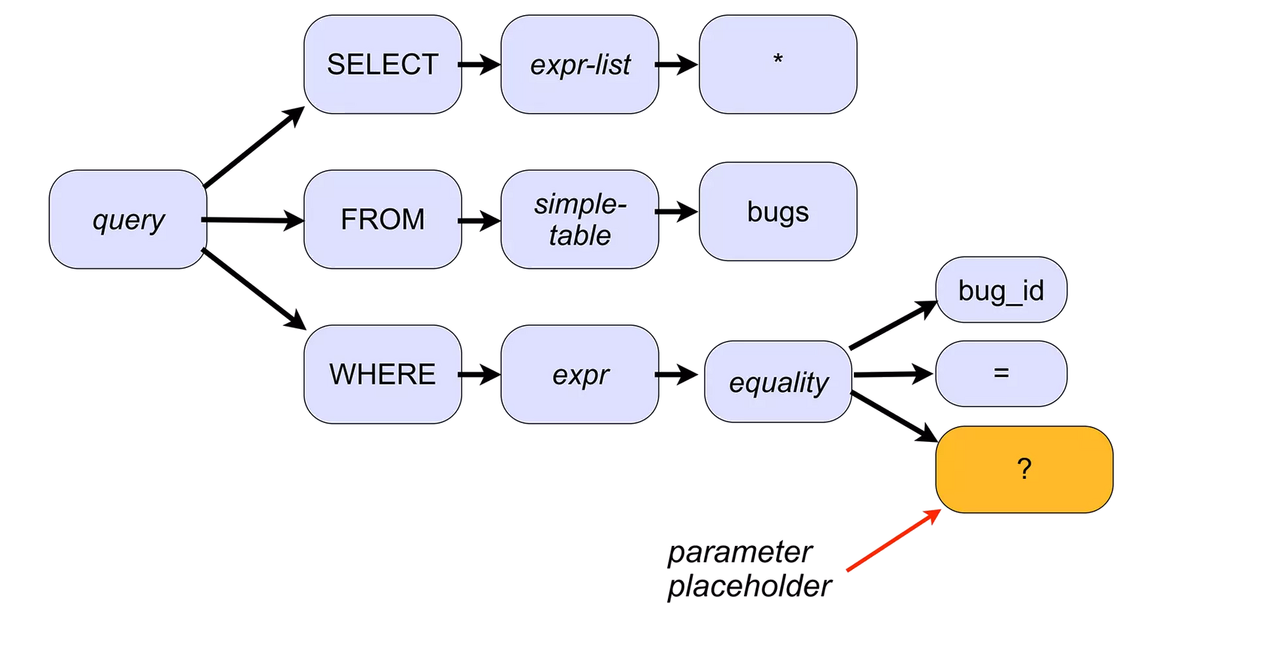
How prepared statements work
Consider the query SELECT * FROM BUGS WHERE bug_id = ?
Database engine parses (compiles) the query as below
Source: slideshare

Slide 28
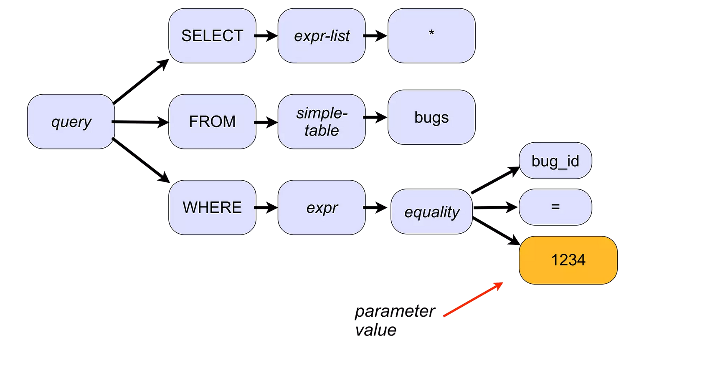
How prepared statements work
Example of normal usage
Source: slideshare

Slide 29
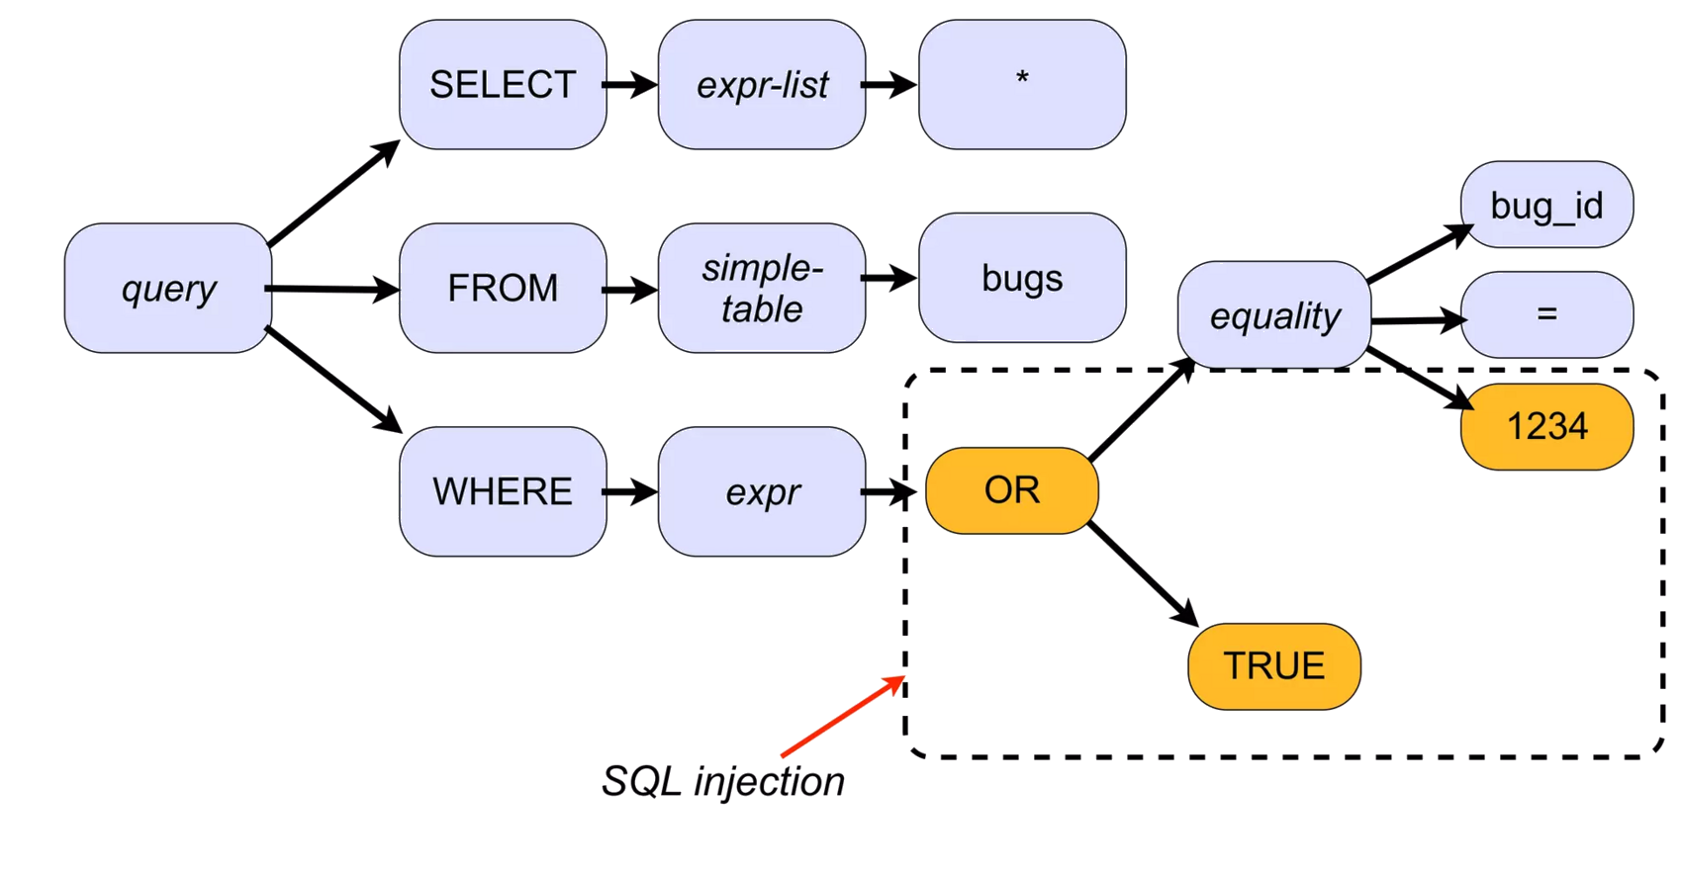
How prepared statements work
When a malicious input is passed in, like 1234 OR True, and query is being prepared with interpolation (or concatenation), it becomes:
Source: slideshare

Slide 30
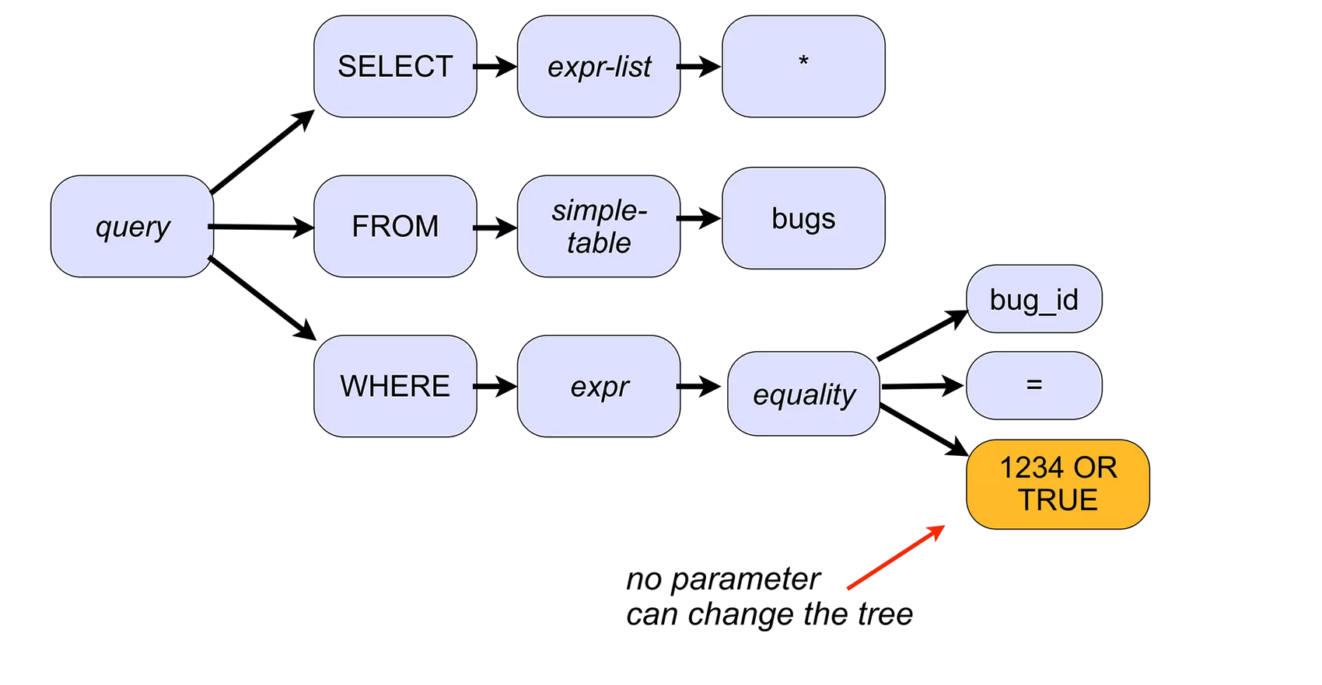
How prepared statements work
With prepared statements, every input is treated as data, not code. So the parse tree can not change.
Source: slideshare

Slide 31
SQLi countermeasures
(2) Stronger data validation
type checking, e.g. to check that inputs that are supposed to be numeric contain no characters other than digits
pattern matching to distinguish normal input from abnormal
(3) Sanitizing inputs
Escape all special characters (quotes, semicolons, hyphens etc.) to sanitize (clean) all inputs from user
e.g. to use a literal single quote in string, include it twice, i.e. 'it''s me' is interpreted as it's me
Further reading:
Prepared statements can’t help in every case: https://stackoverflow.com/a/43235265/1427771

Slide 32
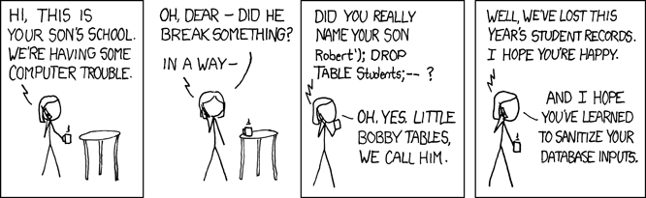
SQLi countermeasures
https://www.explainxkcd.com/wiki/index.php/327:_Exploits_of_a_Mom

Slide 33
SQLi countermeasures
Detection
Signature based
Anomaly based
Code analysis
Runtime prevention: Check queries at runtime to see if they conform to a model of expected queries

Slide 34
Database Access Control

Slide 35
Database Access Control
DBMS can provide specific access rights to portions of the database
e.g. create, insert, delete, update, read, write
to entire database, tables, selected rows or columns
possibly dependent on contents of a table entry
e.g. A teacher can view marks of their own students only
can support a range of policies:
centralized administration
ownership-based administration
decentralized administration

Slide 36
SQL Access Control Commands
To define if a user has access to the entire database or just portions of it, there are two commands:
GRANT {privileges} [ON table] TO {user | PUBLIC} [IDENTIFIED BY password] [WITH GRANT OPTION]
e.g. GRANT SELECT, INSERT ON ANY TABLE TO john
REVOKE {privileges} [ON table] FROM {user | PUBLIC}
e.g. REVOKE SELECT ON ANY TABLE FROM john
Typical access rights (privileges) are: SELECT, INSERT, UPDATE, DELETE, REFERENCES. Column restriction can also be specified where applicable,
e.g. GRANT UPDATE (col1, col2) ...

Slide 37
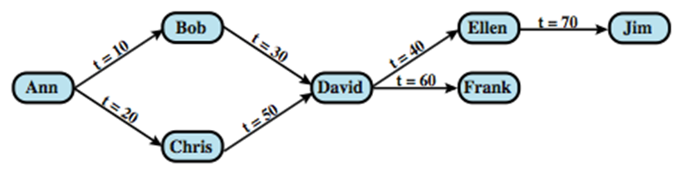
Cascading Authorizations
WITH GRANT OPTION: whether grantee can authorize (GRANT) other users with the same privileges
When this option is included, access right will cascade through.

Slide 38

Cascading Authorizations
It works the same way with revocations.
If Ann revokes Bob’s and Chris’ access
All cascaded access should also be revoked

Slide 39
Cascading Authorizations
Complications can arise in some cases
Bob revokes David’s access
What to do with child accesses?
David’s access was also granted by Chris

Slide 40
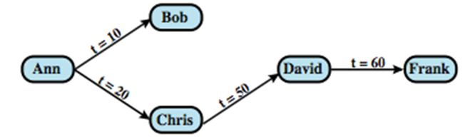
Cascading Authorizations
One option: Consider the access grant times

Slide 41
Role-Based Access Control (RBAC)
Role-based access control work well for DBMS
eases admin burden, improves security
Categories of database users:
application owner
end user
administrator
Administrators are responsible for managing database as a whole (installation, upgrades, security, defining applications etc.)
An application owner must assign roles to end users, e.g. software-engineer, marketing, finance, hr

Slide 42
SQL commands for RBAC
SQL GRANT and REVOKE commands can also be used for role assignments
Syntax
GRANT {role} TO {user}
REVOKE {role} FROM {user}
Examples
GRANT manager TO sarah (role assignment)
GRANT INSERT, SELECT(col3) ON table4 TO manager (privilege assignment to role)
REVOKE manager FROM sarah (role removal)

Slide 43
Database Inference

Slide 44
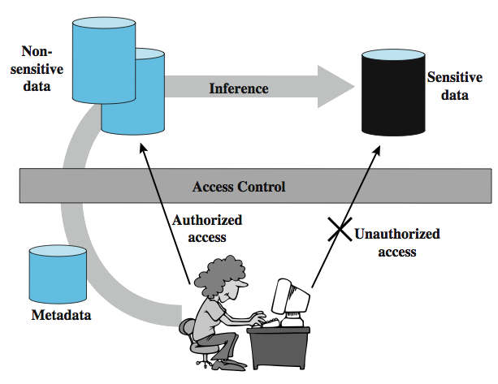
Inference
The process of performing authorized queries and deducing unauthorized information from the legitimate responses received
A combination of data items can be used to infer data of a higher sensitivity

Slide 45
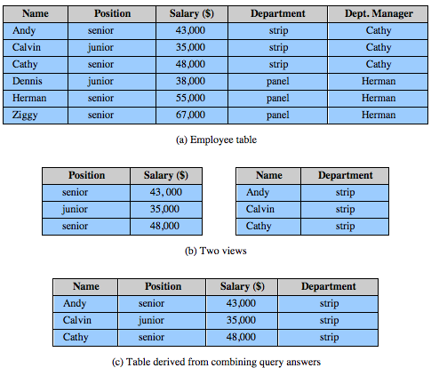
Inference Example
Suppose a user is not allowed to see the salary of a specific employee,
i.e. (Name, Salary) combination can not be in a query
User can still derive the confidential information, because of same data ordering in two views

Slide 46
Inference countermeasures
Inference prevention during database design
Alter database structure or access controls
Splitting a table into multiple tables
More fine-grained access control roles
Inference detection at query time
by monitoring and altering or rejecting queries

Slide 47
Inference prevention during database design
To protect (Name, Salary) pair information, we can distribute data in three tables:
Employees (Emp#, Name, Department) Salaries (S#, Salary) Emp-Salary (Emp#, S#)
Now suppose we want to add a column of employee start dates. Which option is better for preventing inference?
Employees (Emp#, Name, Department) Salaries (S#, Salary, Start-Date) Emp-Salary (Emp#, S#)
OR
Employees (Emp#, Name, Department, Start-Date) Salaries (S#, Salary) Emp-Salary (Emp#, S#)
Protected Table

Slide 48
Statistical Databases
Specialized databased that only provide data of aggregate/summary or statistical nature
e.g. sum, counts, averages
So that privacy of individuals is maintained
Two types:
pure statistical database
ordinary database with statistical access: some users have normal access, others statistical
Security problem is one of inference

Slide 49
Statistical Inference Examples
Example 1
Count (MS.2024.EE.female) = 1
Sum (MS.2024.EE.female, GPA) = 2.7
Example 2
Non secret information:
Salary range for system analyst with BS: (50K, 60K)
Salary range for system analyst with MS: (65K, 70K)
An attacker obtains the sum of all employee salaries
After a new employee joins, same query is run again.
The difference will reveal the new employee’s salary and qualification
Privacy compromised (only one student in group)

Slide 50
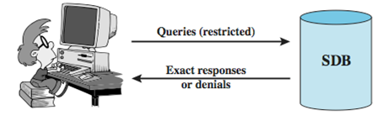
Protecting against Inference
Query restriction
Rejects a query that can lead to a compromise.
The answers provided are accurate.
The simplest is query size restriction.
A query is permitted only if the number of records that match the query condition are more than a threshold, k (where k>1).
In practice, queries over the whole table are allowed, enabling users to easily access statistics calculated on the entire tables.

Slide 51
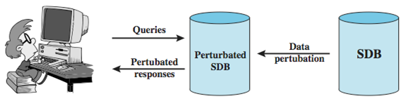
Protecting against Inference
Perturbation
Add noise to statistics generated from data
will result in differences in statistics
Data perturbation
Swap attribute data between rows so that individual records are not accurate, but overall statistics remain similar

Slide 52
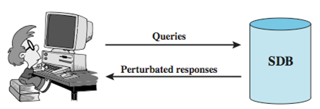
Protecting against Inference
Output perturbation
Random-sample query: Calculate the statistics on a properly selected sampled query subset
Statistic adjustment: Adjusting the answer up or down by a given amount in some systematic fashion
Must minimize loss of accuracy in results

Slide 53
Database Encryption

Slide 54
Database Encryption
Databases typically a valuable info resource
protected by multiple layers of security: firewalls, authentication, OS access control systems, DB access control systems
For particularly sensitive data, DB encryption is the last line of defense
DB Encryption creates challenges
How to distribute decryption keys
How to execute queries, i.e. search for records

Slide 55
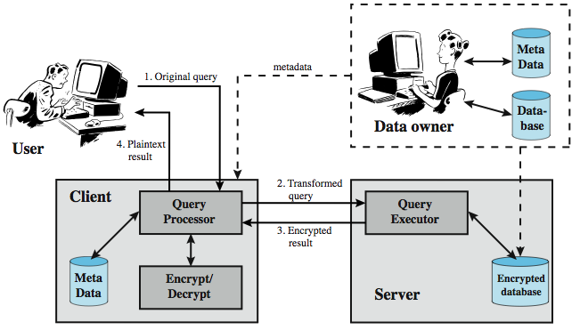
Querying an Encrypted DB

Slide 56
How to Encrypt
Can encrypt
entire database (tables)
very inflexible and inefficient (how to execute queries?)
individual fields
simpler but still inflexible
records (rows)
best if attribute indexes are created to help data retrieval
Varying trade-offs

Slide 57
Field Level Encryption
Suppose that each individual item in the database is encrypted separately.
The encrypted database is stored at the server, but the server does not have the key, so that the data is secure at the server. The client system does have a copy of the encryption key.
A user at the client can retrieve a record from the database with the following sequence:
The user issues SQL query for fields from one or more records with a specific value of the attribute.

Slide 58
Field Level Encryption
The query processor at the client encrypts the attribute parameters, modifies the SQL query accordingly, and transmits the query to the server.
The server processes the query using the encrypted value of the attributes and returns the (encrypted) records.
The query processor decrypts the data and returns the results to user.

Slide 59
Field Level Encryption
Example
SELECT Ename, Eid, Ephone FROM Employee WHERE Did = 15
Assume that the encryption key k is used and that the encrypted value of the department id 15 is E(k, 15) = 1000110111001110.
The query processor at the client could transform the preceding query into SELECT Ename, Eid, Ephone FROM Employee WHERE Did = 1000110111001110

Slide 60
Field Level Encryption
Issues
This method is certainly straightforward but lacks flexibility.
For example, suppose the Employee table contains a salary attribute and the user wishes to retrieve all records for salaries less than 70K.
There is no obvious way to do this, because the attribute value for salary in each record is encrypted.
The set of encrypted values do not preserve the ordering of values in the original attribute.

Slide 61
Record Level Encryption
Each record (row) of a table in the database is encrypted as a whole, and treated as a contiguous block.
For each row in the original database, there is one row in the encrypted database.
To assist in data retrieval, attribute indexes are associated with each table. For some or all of the attributes an index value is created.
For any attribute, the range of attribute values is divided into a set of non-overlapping partitions that encompass all possible values, and an index value is assigned to each partition.

Slide 62
Record Level Encryption
Example
Suppose that employee ID (eid) values lie in the range [1, 1000]. We can divide these values into five partitions: [1, 200], [201, 400], [401, 600], [601, 800], and [801, 1000]; and then assign index values 1, 2, 3, 4, and 5, respectively.
For a text field, we can derive an index from the first letter of the attribute value. For the attribute ename, let us assign index 1 to values starting with A or B, index 2 to values starting with C or D, and so on.
Similar partitioning schemes can be used for each of the attributes.

Slide 63
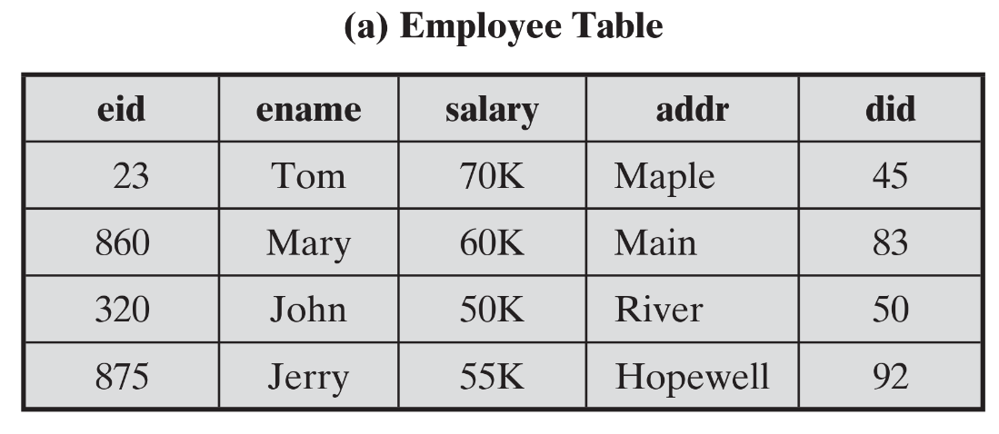
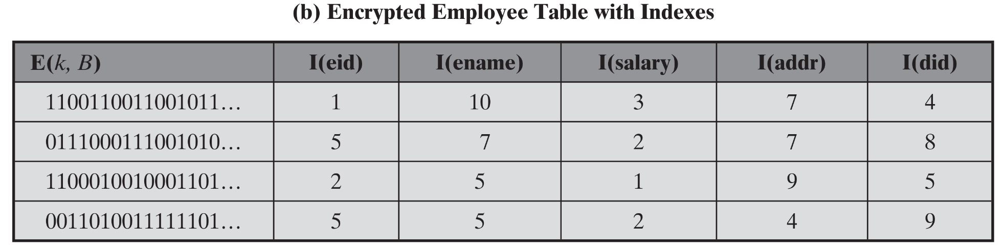
Record Level Encryption
45K ≤ salary < 55K: 1
55K ≤ salary < 65K: 2
65K ≤ salary < 75K: 3
The clause
WHERE salary > 60K gets transformed to
WHERE I(salary) ≥ 2

Slide 64
References
Stallings SPP chap 5

